Slide 1
Superstore Sales Dashboard Insights

Slide 2
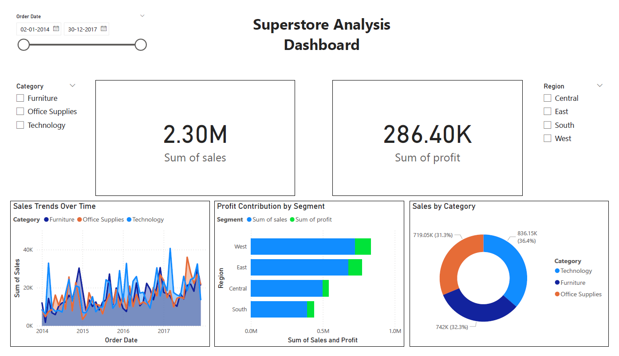

Slide 3
Overall Performance
Sales have shown a steady upward trend over the analyzed period, with the Technology category leading growth.
Profit is highest in the Technology segment, while Furniture shows the lowest profit margins.
Key Insights
West region consistently had the highest sales from Q3 2021 to Q2 2022, indicating strong customer engagement and market penetration in that region.
The Technology category had the highest profit margins across all regions, suggesting it is the most lucrative product category despite not always having the highest sales volume.
Furniture sales dropped significantly in Q4 2021, possibly due to reduced demand or supply chain issues, despite increased promotional efforts during that period.
The South region showed steady growth in overall sales over time, but profit margins remained lower, indicating higher costs or more discounts applied in that area.
Visual Highlights
Line Chart: Sales growth over time, with Technology outpacing other categories.
Donut Chart: Displaying sales distribution among categories.
Bar Chart: Sales by Region, comparing profits and sales across different regions.

